Slide 1
Regression Model & evaluation metrics
In machine learning

Slide 2
What is Regression?
Regression is a statistical approach used to analyze the relationship between a dependent variable (target variable) and one or more independent variables (predictor variables). The objective is to determine the most suitable function that characterizes the connection between these variables.
It seeks to find the best-fitting model, which can be utilized to make predictions or draw conclusions.

Slide 3
Regression in Machine Learning
It is a supervised machine learning technique, used to predict the value of the dependent variable for new, unseen data.
It models the relationship between the input features and the target variable, allowing for the estimation or prediction of numerical values.
Regression analysis problem works with if output variable is a real or continuous value, such as “salary” or “weight”.
Many different models can be used, the simplest is the linear regression.
It tries to fit data with the best hyper-plane which goes through the points.

Slide 4
Characteristics of Regression
Continuous Target Variable: Regression deals with predicting continuous target variables that represent numerical values. Examples include predicting house prices, forecasting sales figures, or estimating patient recovery times.
Error Measurement: Regression models are evaluated based on their ability to minimize the error between the predicted and actual values of the target variable. Common error metrics include mean absolute error (MAE), mean squared error (MSE), and root mean squared error (RMSE).
Model Complexity: Regression models range from simple linear models to more complex nonlinear models. The choice of model complexity depends on the complexity of the relationship between the input features and the target variable.
Overfitting and Underfitting: Regression models are susceptible to overfitting and underfitting.
Interpretability: The interpretability of regression models varies depending on the algorithm used. Simple linear models are highly interpretable, while more complex models may be more difficult to interpret.

Slide 5
Terminologies Related to the Regression Analysis
Response Variable: The primary factor to predict or understand in regression, also known as the dependent variable or target variable.
Predictor Variable: Factors influencing the response variable, used to predict its values; also called independent variables.
Outliers: Observations with significantly low or high values compared to others, potentially impacting results and best avoided.
Multicollinearity: High correlation among independent variables, which can complicate the ranking of influential variables.
Underfitting and Overfitting: Overfitting occurs when an algorithm performs well on training but poorly on testing, while underfitting indicates poor performance on both datasets.

Slide 6
Regression Types
Simple Regression
Used to predict a continuous dependent variable based on a single independent variable.
Simple linear regression should be used when there is only a single independent variable.
Multiple Regression
Used to predict a continuous dependent variable based on multiple independent variables.
Multiple linear regression should be used when there are multiple independent variables.
NonLinear Regression
Relationship between the dependent variable and independent variable(s) follows a nonlinear pattern. Provides flexibility in modeling a wide range of functional forms.

Slide 7
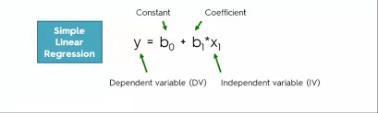

Slide 8
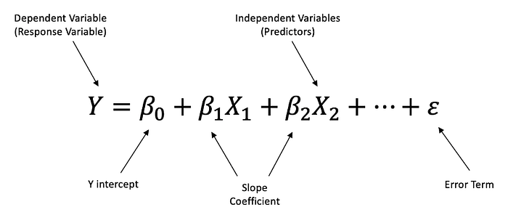

Slide 9
Regression Algorithms
Linear Regression
Statistical model. This assumes that there is a linear relationship between the independent and dependent variables. This means that the change in the dependent variable is proportional to the change in the independent variables.
Polynomial Regression
Polynomial regression is used to model nonlinear relationships between the dependent variable and the independent variables. It adds polynomial terms to the linear regression model to capture more complex relationships.
Support Vector Regression (SVR)
Support vector regression (SVR) is a type of regression algorithm that is based on the support vector machine (SVM) algorithm. SVM is a type of algorithm that is used for classification tasks, but it can also be used for regression tasks. SVR works by finding a hyperplane that minimizes the sum of the squared residuals between the predicted and actual values.

Slide 10
Regression Algorithms
Decision Tree Regression
Algorithm that builds a decision tree to predict the target value. A decision tree is a tree-like structure that consists of nodes and branches. Each node represents a decision, and each branch represents the outcome of that decision. The goal of decision tree regression is to build a tree that can accurately predict the target value for new data points.
Random Forest Regression
An ensemble method that combines multiple decision trees to predict the target value. Ensemble methods are a type of machine learning algorithm that combines multiple models to improve the performance of the overall model. Random forest regression works by building a large number of decision trees, each of which is trained on a different subset of the training data. The final prediction is made by averaging the predictions of all of the trees.

Slide 11
Regularized Linear Regression Techniques
Ridge Regression
Ridge regression is a type of linear regression that is used to prevent overfitting. Overfitting occurs when the model learns the training data too well and is unable to generalize to new data.
Lasso regression
Lasso regression is another type of linear regression that is used to prevent overfitting. It does this by adding a penalty term to the loss function that forces the model to use some weights and to set others to zero.

Slide 12
Mean Absolute Error(MAE)
MAE is a very simple metric which calculates the absolute difference between actual and predicted values.
Let’s take an example, you have input data and output data and use Linear Regression, which draws a best-fit line.
Now you have to find the MAE of your model which is basically a mistake made by the model known as an error. Now find the difference between the actual value and predicted value that is an absolute error but we have to find the mean absolute of the complete dataset.
So, sum all the errors and divide them by a total number of observations And this is MAE. And we aim to get a minimum MAE because this is a loss.

Slide 13
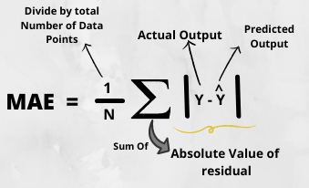
from sklearn.metrics import mean_absolute_error
print("MAE",mean_absolute_error(y_test,y_pred))

Slide 14
MAE
Advantages of MAE
The MAE you get is in the same unit as the output variable.
It is most Robust to outliers.
Disadvantages of MAE
The graph of MAE is not differentiable so we have to apply various optimizers like Gradient descent which can be differentiable.

Slide 15
Mean Squared Error(MSE)
MSE is a most used and very simple metric with a little bit of change in mean absolute error. Mean squared error states that finding the squared difference between actual and predicted value.
So, above we are finding the absolute difference and here we are finding the squared difference.
What actually the MSE represents? It represents the squared distance between actual and predicted values. We perform squared to avoid the cancellation of negative terms and it is the benefit of MSE.

Slide 16
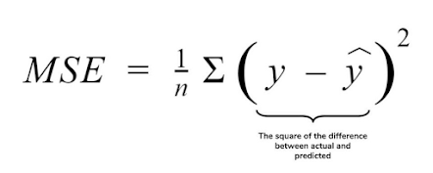
from sklearn.metrics import mean_squared_error
print("MSE",mean_squared_error(y_test,y_pred))

Slide 17
MSE
Advantages of MSE
The graph of MSE is differentiable, so you can easily use it as a loss function.
Disadvantages of MSE
The value you get after calculating MSE is a squared unit of output. for example, the output variable is in meter(m) then after calculating MSE the output we get is in meter squared.
If you have outliers in the dataset then it penalizes the outliers most and the calculated MSE is bigger. So, in short, It is not Robust to outliers which were an advantage in MAE.

Slide 18
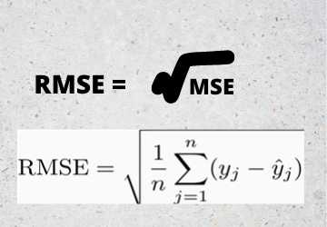
Root Mean Squared Error(RMSE)
As RMSE is clear by the name itself, that it is a simple square root of mean squared error.
print("RMSE",np.sqrt(mean_squared_error(y_test,y_pred)))

Slide 19
RMSE
Advantages of RMSE
The output value you get is in the same unit as the required output variable which makes interpretation of loss easy.
Disadvantages of RMSE
It is not that robust to outliers as compared to MAE.
For performing RMSE we have to NumPy NumPy square root function over MSE.

Slide 20
Root Mean Squared Log Error(RMSLE)
Taking the log of the RMSE metric slows down the scale of error. The metric is very helpful when you are developing a model without calling the inputs. In that case, the output will vary on a large scale.
To control this situation of RMSE we take the log of calculated RMSE error and resultant we get as RMSLE.
To perform RMSLE we have to use the NumPy log function over RMSE.
print("RMSE",np.log(np.sqrt(mean_squared_error(y_test,y_pred))))

Slide 21
R Squared (R2)
R2 score is a metric that tells the performance of your model, not the loss in an absolute sense that how many wells did your model perform.
In contrast, MAE and MSE depend on the context as we have seen whereas the R2 score is independent of context.
So, with help of R squared we have a baseline model to compare a model which none of the other metrics provides. The same we have in classification problems which we call a threshold which is fixed at 0.5. So basically R2 squared calculates how must regression line is better than a mean line.
Hence, R2 squared is also known as Coefficient of Determination or sometimes also known as Goodness of fit.

Slide 22
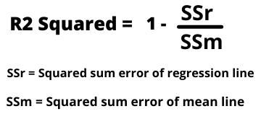
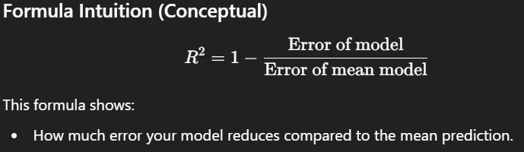
R² Value | Meaning
1 | Perfect fit
0 | Same as mean model
< 0 | Worse than mean model
0.7 | Model explains 70% of variance
What is R-Squared (R²)?
R-Squared (R²) is a performance metric used in regression models to measure how well the model explains the variation in the output data. It does not tell the absolute error value like MAE or MSE. Instead, it tells how good the model is compared to a baseline model.
What does R² actually measure?
R² measures how much better your regression model is compared to a simple mean-based model.
The baseline model predicts the mean of the target variable for all inputs.
R² checks whether your regression line performs better than this mean line.
📌 In simple words: R² shows how much variation in the output is explained by your model.
Notes:
Relation to Classification Threshold
In classification:
A fixed threshold (usually 0.5) is used to evaluate performance.
In regression:
R² acts as that fixed reference point
It tells whether your model is better than a naive prediction (mean)
Why R² is called Coefficient of Determination
It determines how much variation in the output is explained by inputs.
It shows the goodness of fit of the regression line.
📌 That’s why R² is also known as:
Coefficient of Determination
Goodness of Fit

